Slide 1
ENSF-612
Project Presentation III
Presented By:
Group 1
Taruneesh Sachdeva
Neha Singh
Sanyam

Slide 2
Q1) How was data collected and labeled
We took 3 datasets from ‘https://www.st.cs.uni-saarland.de/softevo//bugclassify/collated them and further added 1000 new issue reports which were manually classified. We combined all the dataframes into one single dataframe called df_issue_report which contains the Summary and label column.
Based on the Summary column, we manually classified the additional 1000 issue reports.
The next slide shows some of the issue IDs on which we had disagreements:

Slide 3
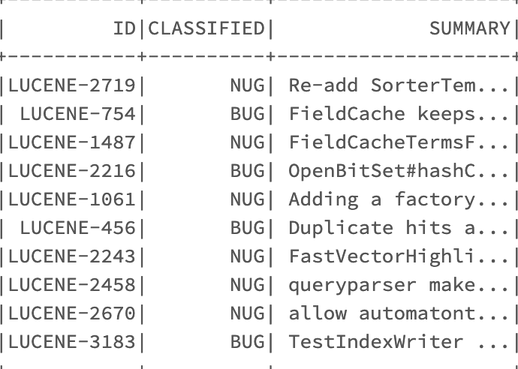

Slide 4
Percentage Agreements
Taruneesh and Sanyam agreed on 40 labels out of 50, therefore the percentage agreement was 80%.
Similarly, Sanyam and Neha agreed on 42 labels out of 50, therefore the percentage agreement was 84%.
Neha and Taruneesh had an agreement on 44 out of 50 labels. Therefore, the percentage agreement was 88%.

Slide 5
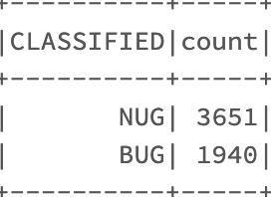
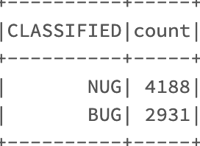
Q2) How does newly added data compare with the original data
In the old data from the research paper, we had 3651 NUGS and 1940 BUGS.
After we manually classified the data, the count came out to be 4188 NUGS and 2931 BUGS.

Slide 6
DETAILS
In short, we added 537 NUGS and 991 BUGS.
The reason we added more BUGS as compared to NUGS was that the initial count of NUGS in the research paper was twice as much as BUGS.
Therefore, to balance our dataset, while manually classifiying the data, we added twice as much BUGS as NUGS.
After Manual Classification, the percentage of NUGS was 58.8% as compared to 41.2% for BUGS.

Slide 7
Q3) How was the data pre-processed
We implemented a function preProcessData() for :
The removal of punctuation,
The removal of spaces
Conversion to lower case and any further noise.
Also for the remaining preprocessing, we made separate three functions for
Tokenization of Data
Removal of stopwords
Stemming

Slide 8
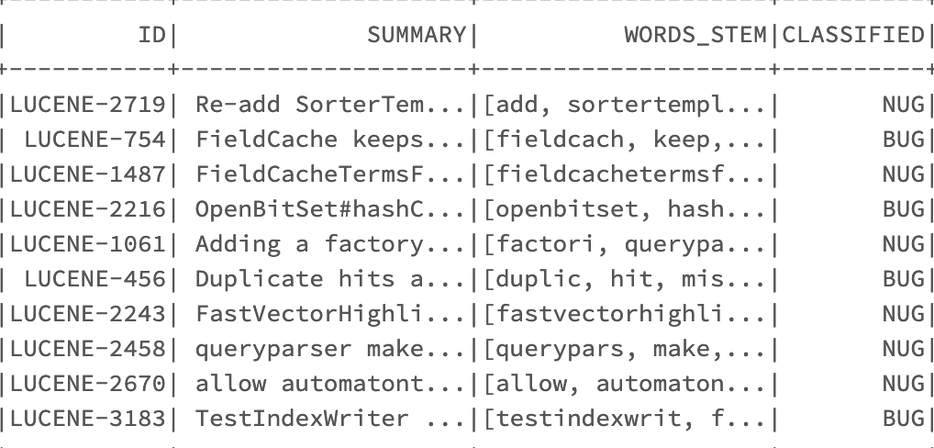
Clean dataframe

Slide 9
Q4) How do the models perform on the original data vs original + new data
We calculated the Precision, weighted F1-measure and recall of both the Old and Old+New dataset.
The following table has the scores for old dataset with normalization.
Model(Classifiers) | Naive Bayes | Linear SVC | Random Forest
Metrics
Accuracy | 0.71 | 0.80 | 0.79
Average Precision | 0.90 | 0.70 | 0.80
F1-score | 0.29 | 0.71 | 0.62
Recall | 0.17 | 0.72 | 0.51

Slide 10
The following table has the scores for old dataset without normalization.
Model(Classifiers) | Naive Bayes | Linear SVC | Random Forest
Metric
Accuracy | 0.85 | 0.80 | 0.78
Average Precision | 0.76 | 0.75 | 0.78
F1-score | 0.78 | 0.73 | 0.59
Recall | 0.79 | 0.71 | 0.47

Slide 11
The following table has the scores for old+new dataset with normalization.
Model(Classifiers) | Naive Bayes | Linear SVC | Random Forest
Metric
Accuracy | 0.73 | 0.77 | 0.76
Average Precision | 0.88 | 0.73 | 0.82
F1 score | 0.56 | 0.72 | 0.67
Recall | 0.41 | 0.72 | 0.56

Slide 12
The following table has the scores for old+new dataset without normalization.
Model(Classifiers) | Naive Bayes | Linear SVC | Random Forest
Metric
Accuracy | 0.82 | 0.78 | 0.76
Average Precision | 0.80 | 0.75 | 0.81
F1-score | 0.79 | 0.73 | 0.65
Recall | 0.77 | 0.71 | 0.55

Slide 13
Conclusion on models performance on old+new dataset
From the results, we observe that Linear SVC performs best out of the three models with F1 score ranging between .71-.73 and the factor of normalization doesn’t affect the scores in the model.
Naive Bayes performs better without normalization on any dataset with F1 score of .79 compared to .59/.29 with normalisation.
Random Forest Classifier performs same with or without normalization with F1 score average .65.
Overall, adding the new dataset did not make much difference.

Slide 14
Comparison on models performance between old dataset vs old+new dataset
Overall, adding the new data set is not making much difference.
However, our all the models are performing at par with the results given in the research paper.
The highest f-measures values mentioned by the papers are in range of 0.6 to 0.83, but the indicator they have used is weighted F-measure, which generally gives higher value than the normal F-measure.
Best F-measure score are 0.79 and 0.73 for Naïve Bayes and Linear SVC model. For, all cases Linear SVC performs better than naïve bayes.

Slide 15
Q5) How does the performance of models change based on the choice of hyper-parameters
RFC scores change significantly after changing the hyperparameters to (numTrees= 60, maxDepth=30, maxBins=40)
The score for Naive Bayes and Linear SVM remained the same
The next slide shows the scores for Random Forest Classifier with and without normalization and on old + new datasets

Slide 16
Scores for Random Forest Classifier with and without hyper-parameter on old+new dataset (with normalization)
With Hyperparameter on old + new dataset
Without Hyperparameter on old + new dataset
Model(Classifiers) | Random Forest
Metric
Accuracy | 0.76
Average Precision | 0.82
F1-score | 0.67
Recall | 0.56
Model(Classifiers) | Random Forest
Metric
Accuracy | 0.61
Average Precision | 0.91
F1-score | 0.17
Recall | 0.09

Slide 17
Q6) How are misclassifications of the best performing model distributed
The Best Performing model is Linear Support Vector Machine (LSVM) in all cases.
Now, we analyze the cases where our best model predicted wrong results.
In the next slide, we draw a table showing the some examples of misclassifications in our model.
CLASSIFIED column is our label column (1 for BUG and 0 for NUG), the prediction column represents what our model predicted and SUMMARY column is the summary of the issue report

Slide 18
CLASSIFIED_LABEL | prediction | SUMMARY
0 | 1.0 | increase default maxFieldLength
0 | 1.0 | Hitting disk full during DocumentWriter.ThreadState.init(...) can cause hang
0 | 1.0 | Fix StandardAnalyzer to not mis-identify HOST as ACRONYM by default
1 | 0.0 | Possible hidden exception on SegmentInfos commit
0 | 1.0 | Sun hotspot compiler bug in 1.6.0_04/05 affects Lucene

Slide 19
Possible reason for mis-classification by models:
1. Fix StandardAnalyzer to not mis-identify HOST as ACRONYM by default – Prediction 1, Classified - 0
Reason
a) Fix junit scope in maven pom (Example) – It is a BUG
b) Keyword – not, mis-identify
These normally directs a query towards BUG
2. Sun hotspot compiler bug in 1.6.0_04/05 affects Lucene
Reason
a) Keyword ‘bug’ straightaway directs a query towards BUG

